Slide 1
Floating-point Arithmetic operations:
In many high-level programming languages we have a facility for specifying floating-point numbers. The most common way is by a real declaration statement. High level programming languages must have a provision for handling floating-point arithmetic operations.
The operations are generally built in the internal hardware. If no hardware is available, the compiler must be designed with a package of floating-point software subroutine.
Although the hardware method is more expensive, it is much more efficient than the software method. Therefore, floating- point hardware is included in most computers and is omitted only in very small ones.

Slide 2
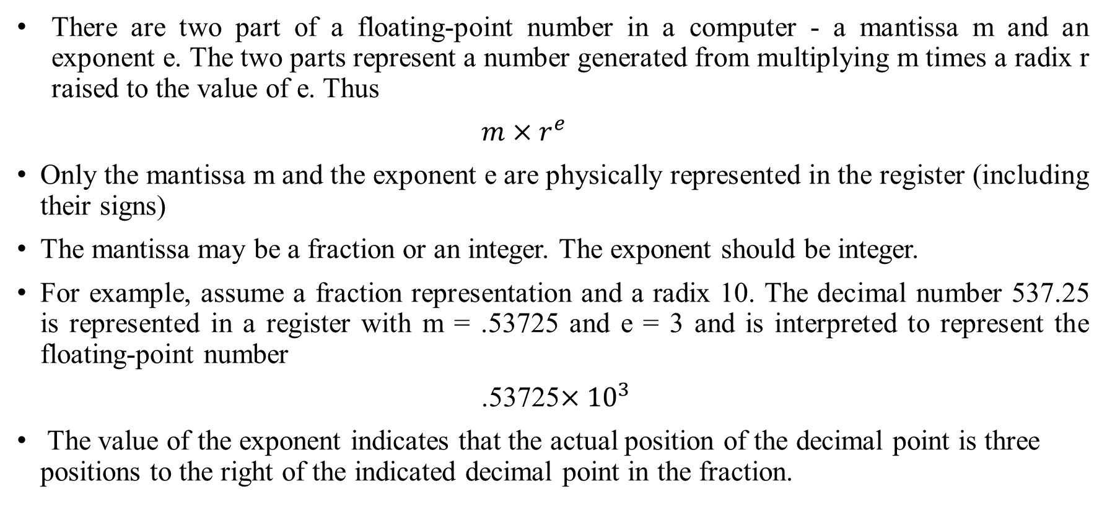
Basic Considerations :
There are two part of a floating-point number in a computer - a mantissa m and an exponent e. The two parts represent a number generated from multiplying m times a radix r raised to the value of e. Thus
$m×r^{e}$
Only the mantissa m and the exponent e are physically represented in the register (including their signs)
The mantissa may be a fraction or an integer. The exponent should be integer.
For example, assume a fraction representation and a radix 10. The decimal number 537.25 is represented in a register with m = .53725 and e = 3 and is interpreted to represent the floating-point number
.53725$×{10}^{3}$
The value of the exponent indicates that the actual position of the decimal point is three positions to the right of the indicated decimal point in the fraction.

Slide 3

A floating-point binary number is represented in a similar manner except that it uses base 2 for the exponent. For example, the binary number + 1001 . 1 10 is represented with an 8-bit fraction and 6-bit exponent a s follows
Fraction Exponent
01001110 00100
The fraction has a 0 in the leftmost position to denote positive. The binary point of the fraction follows the sign bit but is not shown in the register. The exponent has the equivalent binary number +4. The floating-point number is equivalent to
A floating-point number is said to be normalized if the most significant digit of the mantissa in nonzero. So the mantissa contains the maximum possible number of significant digits. For example, the decimal number 350 is normalized but 00035 is not.
We cannot normalize a zero because it does not have a nonzero digit. It is represented in floating-point by all 0’s in the mantissa and exponent.

Slide 4
Floating-point representation increases the range of numbers for a given register. Consider a computer with 48-bit words.
The 48 bits can be used to represent a floating-point number with 36 bits for the mantissa and 12 bits for the exponent.
Floating Point Arithmetic Operations:
Arithmetic operations with floating-point numbers are more complicated than with fixed-point numbers. Their execution also takes longer time and requires more complex hardware.
Adding or subtracting two numbers requires first an alignment of the radix point since the exponent parts must be made equal before adding or subtracting the mantissas.
For example: It is necessary that the two exponents be equal before the mantissas can be added. We can either shift the first number three positions to the left, or shift the second number three positions to the right.
When the mantissas are stored in registers, shifting to the left causes a loss of most significant digits. Shifting to the right causes a loss of least significant digits.
The second method is preferable because it only reduces the accuracy, while the first method may cause an error. The usual alignment procedure is to shift the mantissa that has the smaller exponent to the right by a number of places equal to the difference between the exponents.

Slide 5


After this is done, the mantissas can be added:
When two normalized mantissas are added, the sum may contain an overflow digit. An overflow can be corrected easily by shifting the sum once to the right and incrementing the exponent..
When two numbers are subtracted, the result may contain most significant zeros as shown in the following example:
A floating-point number that has a 0 in the most significant position of the mantissa is said to have an underflow. To normalize a number that contains an underflow, it is necessary to shift the mantissa to the left and decrement the exponent until a nonzero digit appears in the first position.
Floating-point multiplication and division do not require an alignment of the mantissas. The product can be formed by multiplying the two mantissas and adding the exponents.

Slide 6
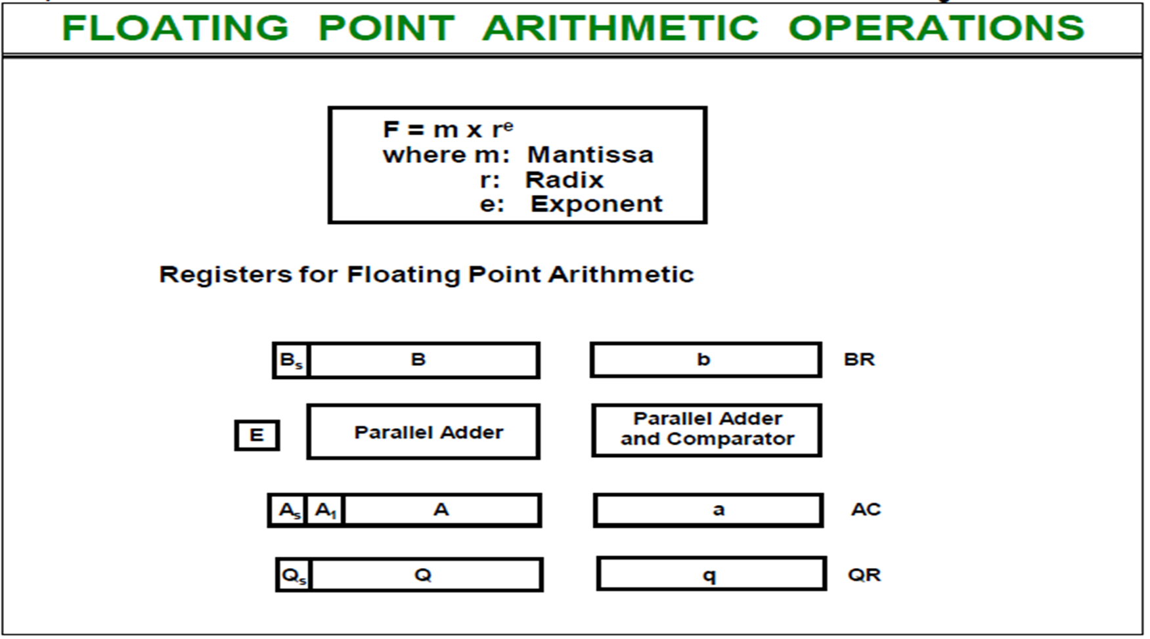
Register Configuration
The register configuration for floating-point operations is shown in figure. As a rule, the same registers and adder used for fixed-point arithmetic are used for processing the mantissas. The difference lies in the way the exponents are handled.
Three registers are there, BR, AC, and QR. Each register is subdivided into two parts. The mantissa part has the same uppercase letter symbols as in fixed-point representation. The exponent part may use corresponding lower-case letter symbol.

Slide 7
It is assumed that each floating-point number has a mantissa in signed magnitude representation and a biased exponent.
Thus the AC has a mantissa whose sign is in As and a magnitude that is in A. The exponent is in the part of the register denoted by the lowercase letter symbol a.
The diagram shows explicitly the most significant bit of A, labeled by A1• The bit in this position must be a 1 for the number to be normalized. Note that the symbol AC represents the entire register, that is, the concatenation of As, A, and a.
Similarly, register BR is subdivided into Bs, B, and b, and QR into Qs, Q ,and q. A parallel-adder adds the two mantissas and transfers the sum into A and the carry into E .
A separate parallel-adder is used for the exponents. Since the exponents are biased, they do not have a distinct sign bit but are represented as a biased positive quantity.

Slide 8
Floating point: Addition and Subtraction
During addition or subtraction, the two floating-point operands are in AC and BR . The sum or difference is formed in the AC . The algorithm can be divided into four consecutive parts:
1. Check for zeros.
2. Align the mantissas.
3. Add or subtract the mantissas.
4. Normalize the result.
A floating-point number that is zero cannot be normalized. If this number is used during the computation, the result may also be zero.
Instead of checking for zeros during the normalization process we check for zeros at the beginning and terminate the process if necessary.

Slide 9
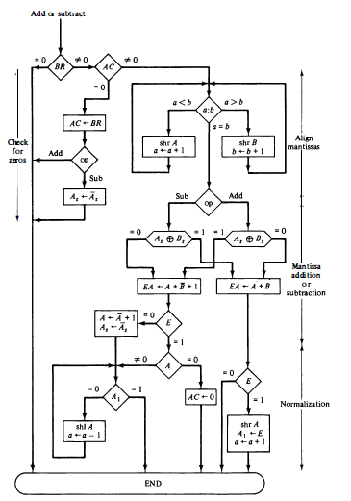
Flowchart: Addition and subtraction of floating point numbers

Slide 10
If BR is equal to zero, the operation is terminated, with the value in the AC being the result. If AC is equal to zero, we transfer the content of BR into AC and also complement its sign if the numbers are to be subtracted. If neither number is equal to zero, we proceed to align the mantissas.
The magnitude comparator attached to exponents a and b provides three outputs that indicate their relative magnitude.
If the two exponents are equal, we go to perform the arithmetic operation.
If the exponents are not equal, the mantissa having the smaller exponent is shifted to the right and its exponent incremented. This process is repeated until the two exponents are equal.
The addition and subtraction of the two mantissas is identical to the fixed-point addition and subtraction algorithm.
The magnitude part is added or subtracted depending on the operation and the signs of the two mantissas.
If an overflow occurs when the magnitudes are added, it is transferred into flip-flop E. If E is equal to 1, the bit is transferred into A1 and all other bits of A are shifted right. The exponent must be incremented to maintain the correct number.

Slide 11
If the magnitudes were subtracted, the result may be zero or may have an underflow.
If the mantissa is zero, the entire floating-point number in the AC is made zero. Otherwise, the mantissa must have at least one bit that is equal to 1.
The mantissa has an underflow if the most significant bit in position A1 is 0. In that case, the mantissa is shifted left and the exponent decremented.
The bit in A1 is checked again and the process is repeated until it is equal to 1. When A1 = 1, the mantissa is normalized and the operation is completed.

